Slide 1
Celebrating E. D. Winstead’s Life
1913 - 2013

Slide 2
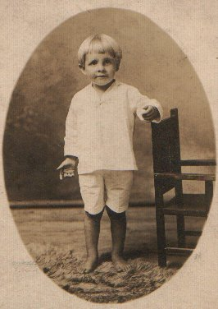
Elton Dewitt “E. D.” Winstead was born in 1913 in Wilson, North Carolina.

Slide 3
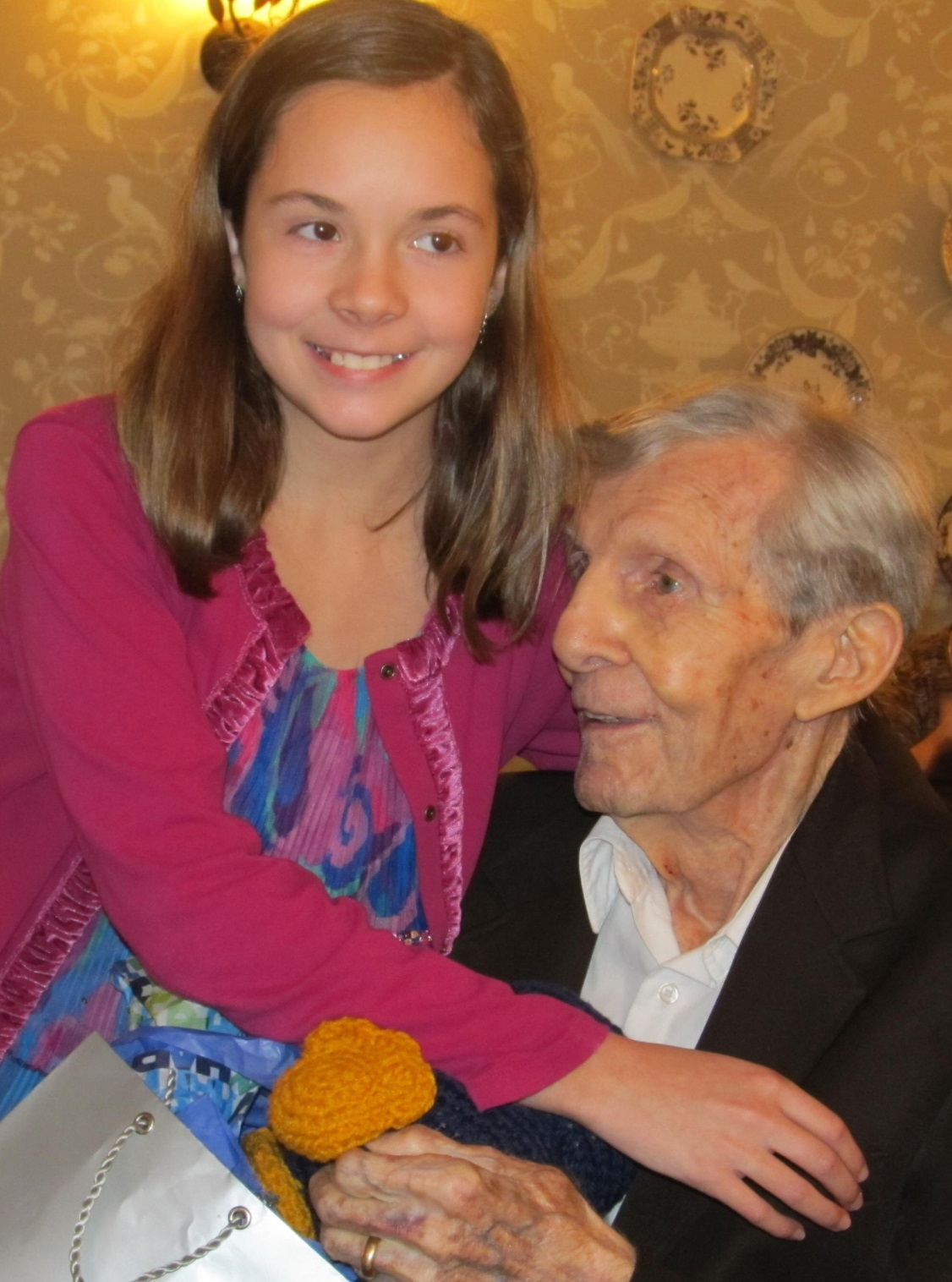
E. D. Winstead Celebrating His 99th Birthday in 2012

Slide 4
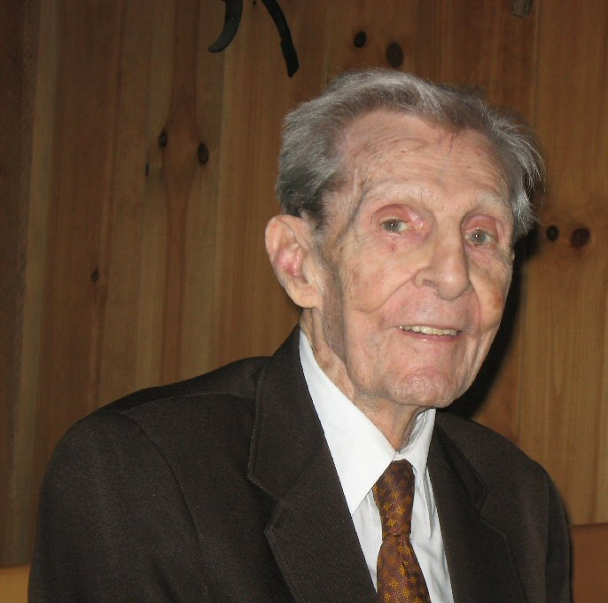
E. D. Winstead Celebrating His 98th Birthday in 2011

Slide 5
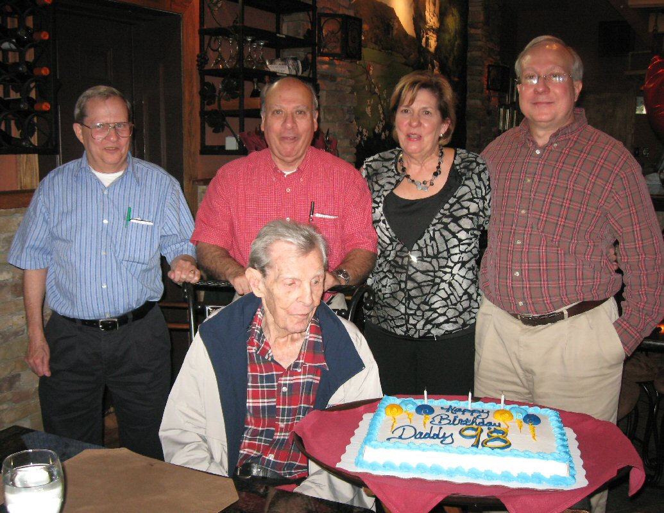
E. D. Winstead celebrating his 98th birthday with his children.

Slide 6
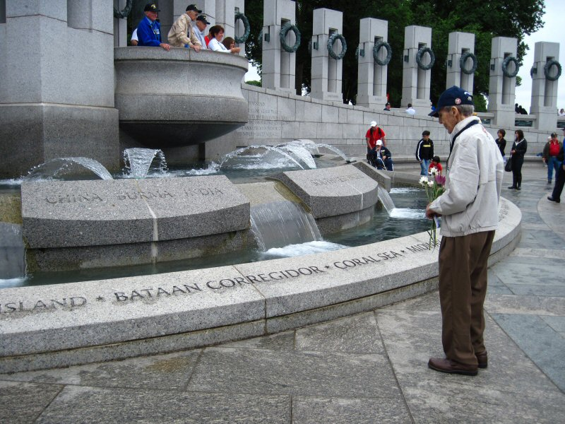
E. D. Winstead at the World War II Memorial in Washington, D. C.
May 14, 2011 Trip sponsored by the Rotary Club.
Standing in front of the Corregidor, Philippines part of the memorial.

Slide 7
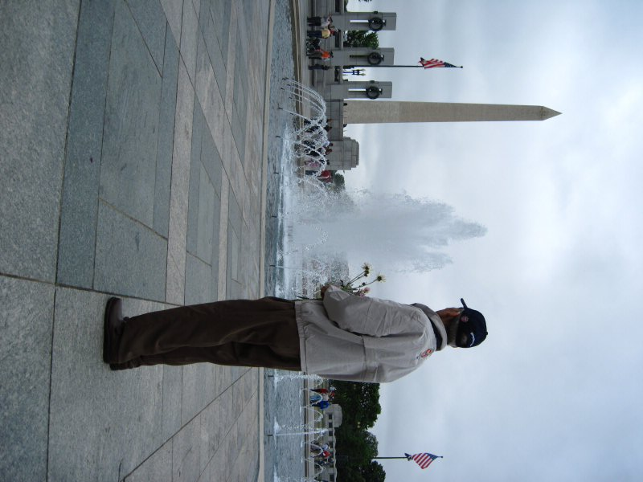
E. D. Winstead at the
World War II Memorial
in Washington, D. C.
May 14, 2011 Trip
sponsored by the
Rotary Club

Slide 8
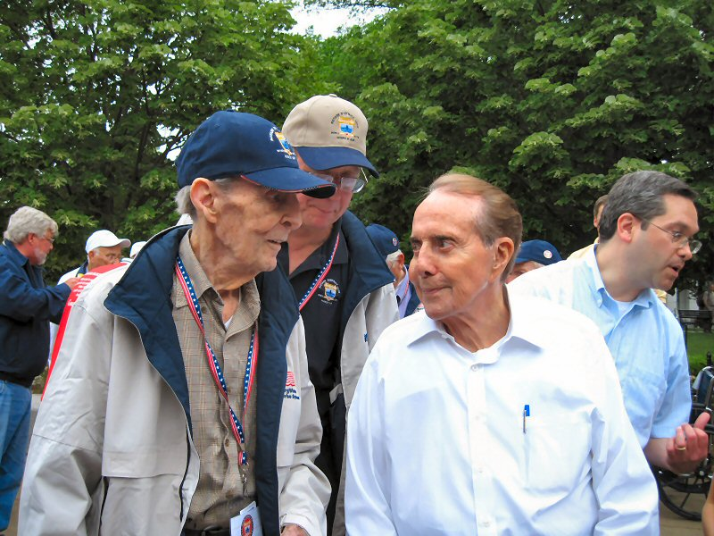
E. D. Winstead with Senator Bob Dole at the World War II Memorial in Washington, D. C.
E. D. Winstead had just been introduced as a former WWII combat veteran and
prisoner of war to Senator Dole.
Bob Dole is a combat veteran seriously wounded in WWII.

Slide 9
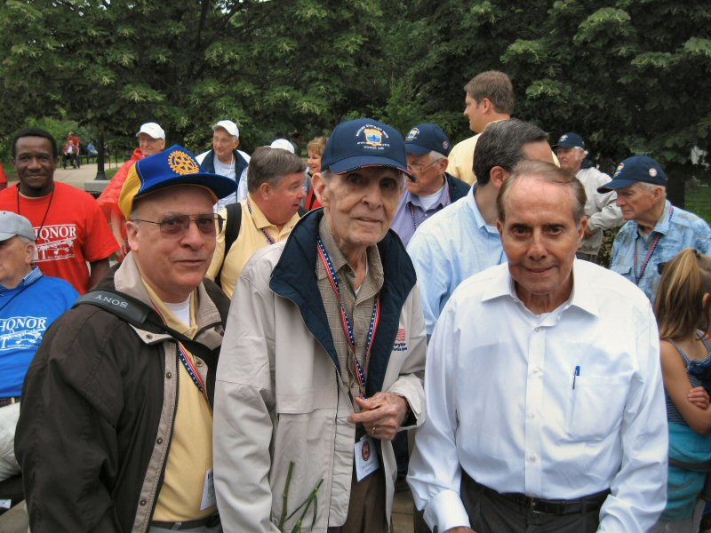
E. D. Winstead's son Ed and E. D. Winstead with Senator Bob Dole
at the World War II Memorial in Washington, D. C.
May 14, 2011 Trip sponsored by the Rotary Club

Slide 10
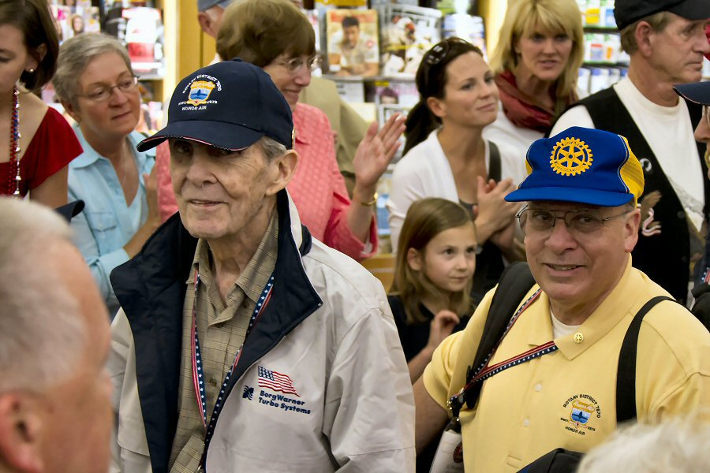
Retired Army Lt. Colonel E. D. Winstead (WWII veteran) and son
retired Army Lt. Colonel Ed Winstead (Vietnam veteran) are welcomed back
to Asheville, NC May 14, 2011 from the trip sponsored by the Rotary Club
to the World War II Memorial in Washington, D. C.

Slide 11
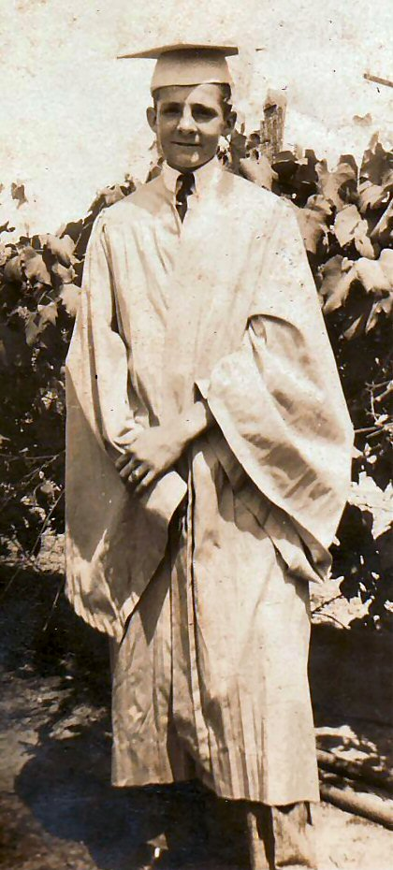
E. D. Winstead as a graduating senior in 1930
from Charles L. Coon High School in Wilson, NC.

Slide 12
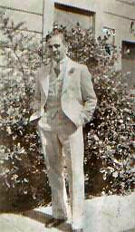
c. 1935 San Francisco, California

Slide 13
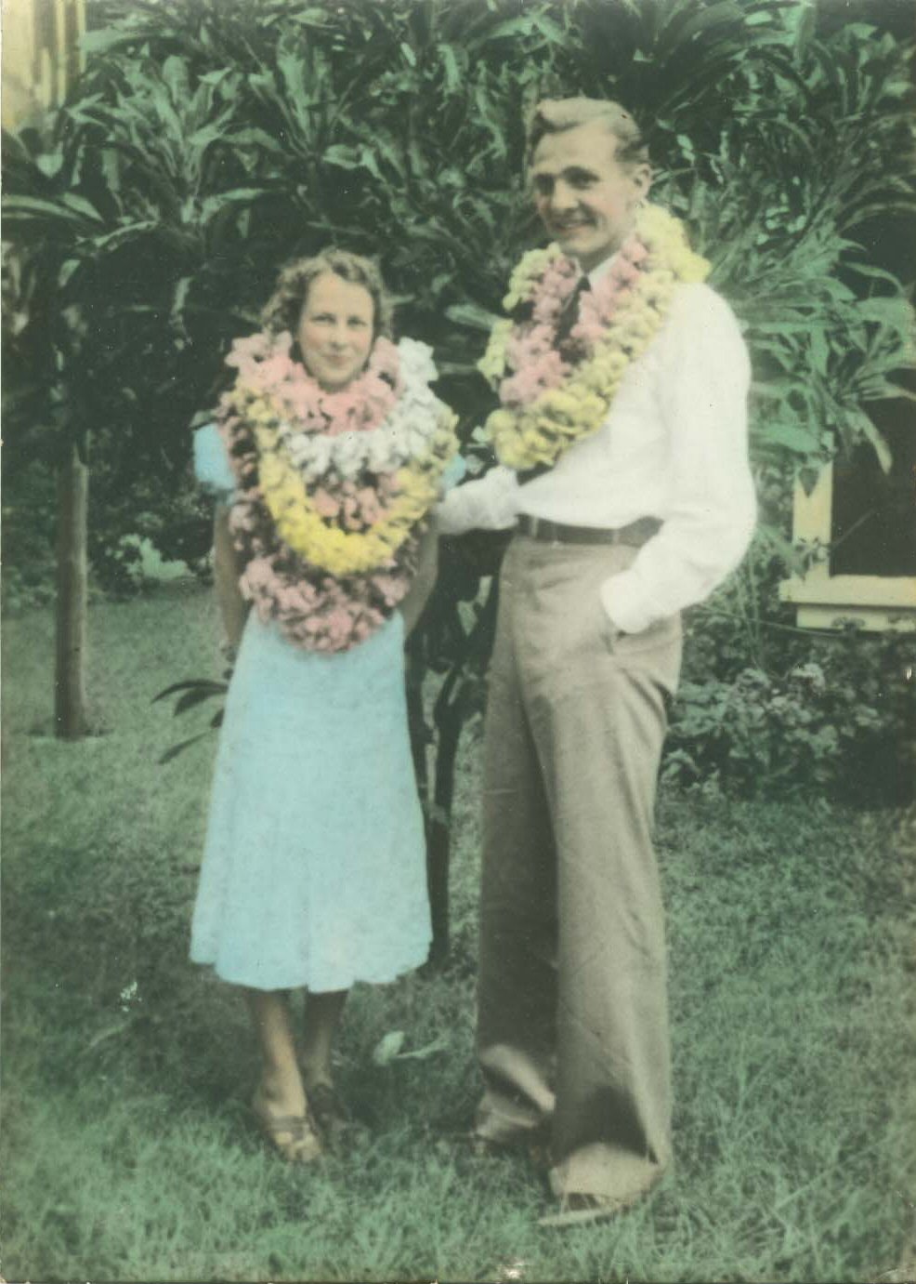
May 1939 in Hawaii with wife Jo

Slide 14
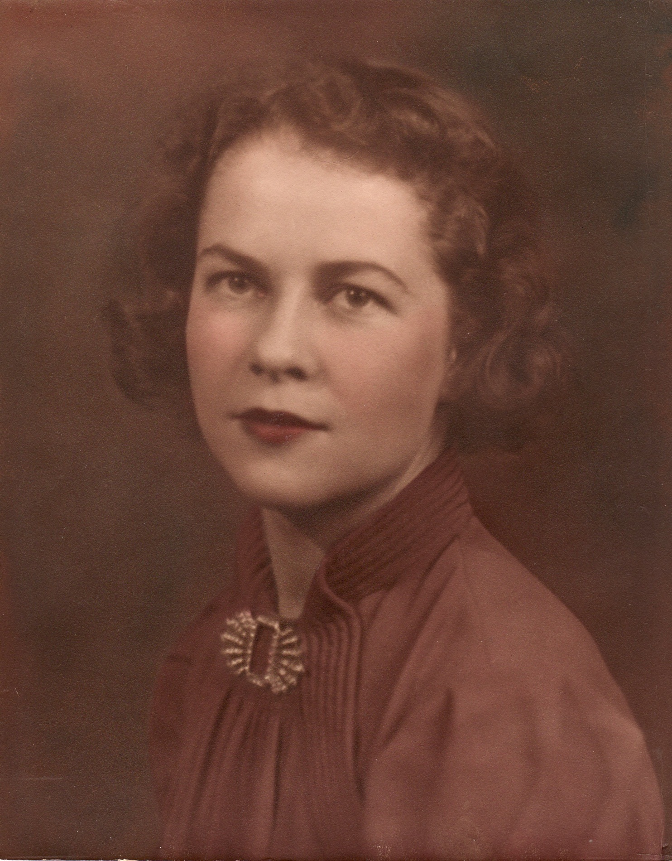
Josephine Minshew Winstead
c. 1938
This is the photograph
E. D. Winstead carried with him throughout WWII as a prisoner of war in the Philippines.

Slide 15
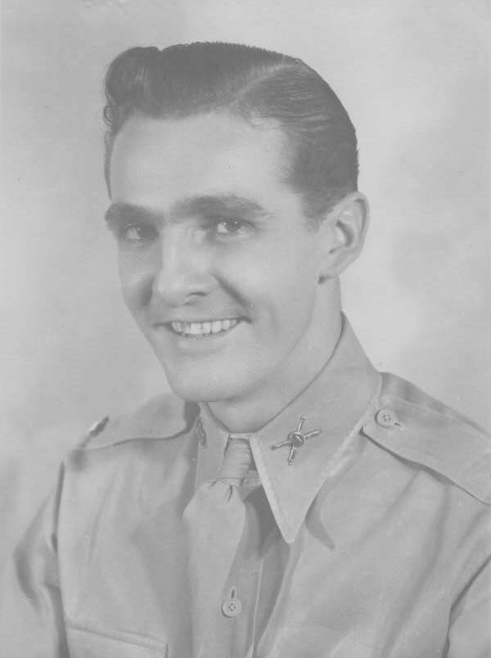
July - August 1941 in Philippines

Slide 16
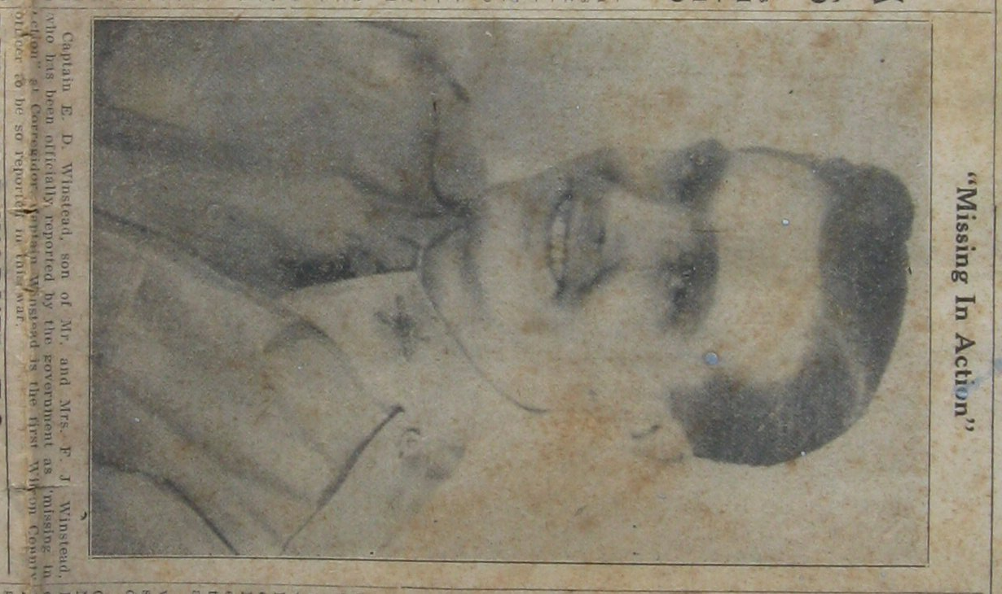

Slide 17
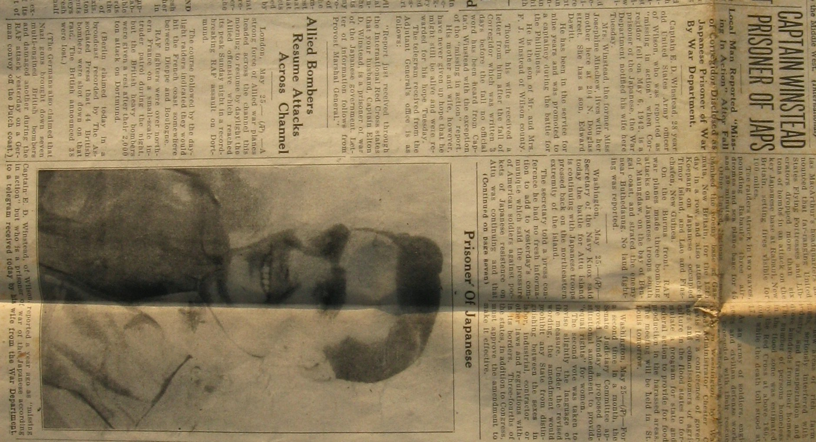

Slide 18
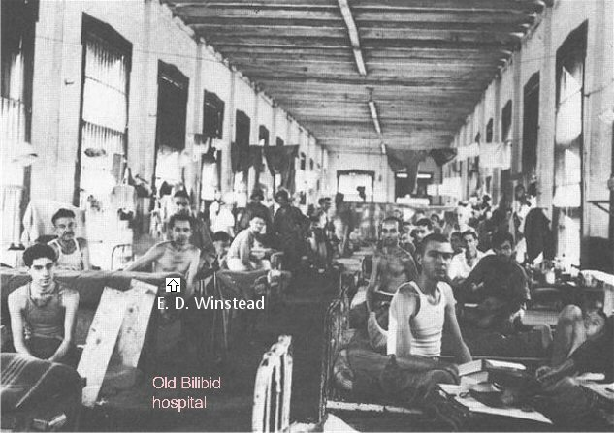
This photograph of rescued Prisoners of War in Bilibid Prison Hospital
1945, Manila, Philippines was published in Life Magazine
and includes Captain E. D. Winstead

Slide 19
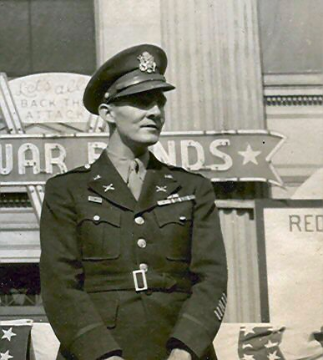
March 31, 1945 Receiving the Key to the City of Wilson, North Carolina
(Recently returned from the Philippines
after being a Japanese Prisoner of War for three years)

Slide 20
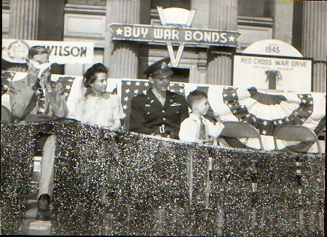
March 31, 1945 Receiving the Key to the City of Wilson, North Carolina
(Recently returned from the Philippines
after being a Japanese Prisoner of War for three years)
F. J. Winstead, Jo Winstead, EDW, Dee Winstead

Slide 21
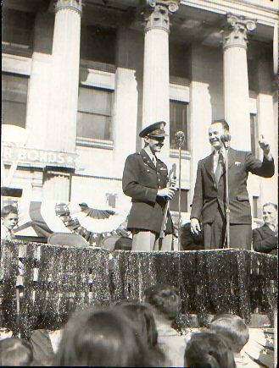
March 31, 1945 Receiving the Key to the City of Wilson, North Carolina
(Recently returned from the Philippines
after being a Japanese Prisoner of War for three years)
Dee Winstead, EDW, Clint Farris (WGTM Radio), ?

Slide 22
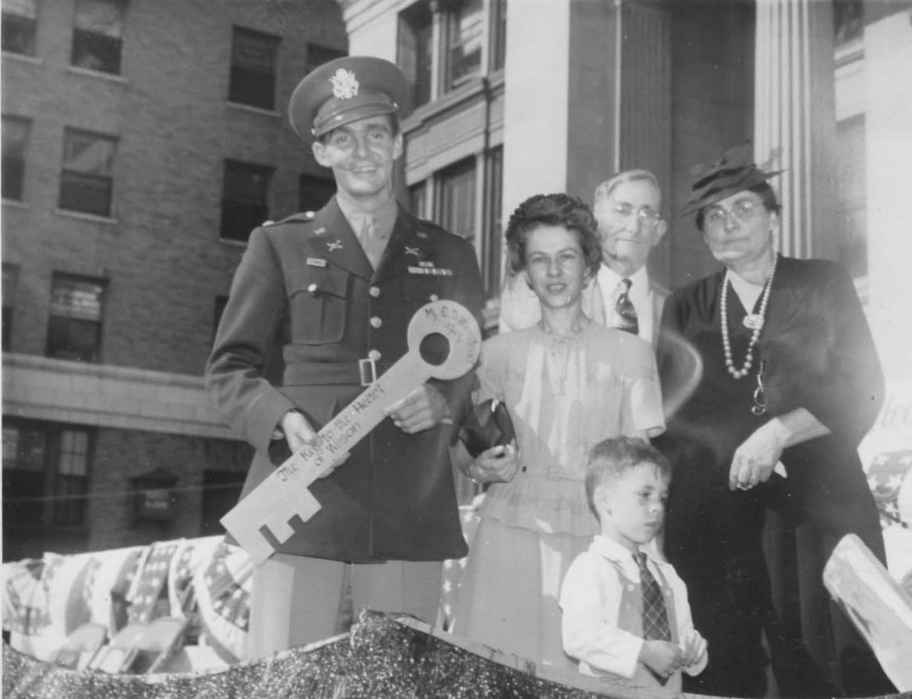
March 31, 1945 Receiving the Key to the City of Wilson, North Carolina
(Recently returned from the Philippines
after being a Japanese Prisoner of War for three years)
E. D. Winstead, wife Jo, father Frank, mother Nettie, son Dee.

Slide 23
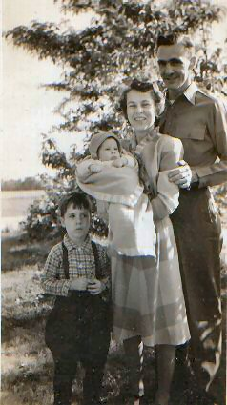
1946 EDW with wife Josephine Minshew Winstead,
older son Ed "Dee," and younger son Ray.

Slide 24
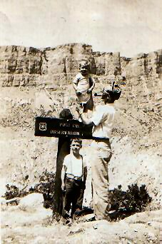
1947 with Dee and Ray

Slide 25
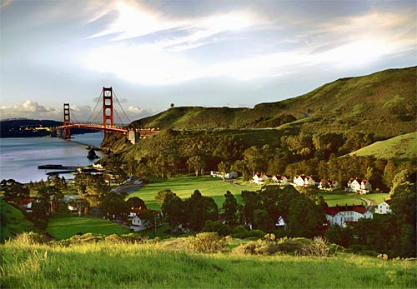
Ft. Baker, California in foreground across the bay from San Francisco, CA near Golden Gate Bridge. Out of the five red-roofed houses shown on the other side of the parade ground (ignoring the long, black-roofed building on the far left), we lived in the second red-roofed house from the left. This photo appeared in the Los Angeles Times:
(http://www.latimes.com/travel/la-tr-cavallo28-2008sep28-pg,0,2235074.photogallery?track=rss)

Slide 26
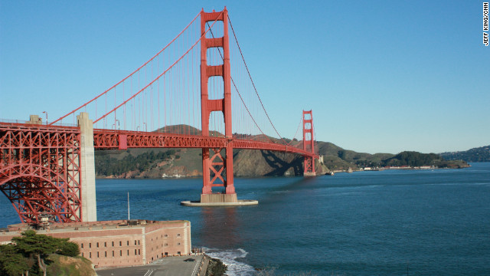
Ft. Baker, California on right across the bay from San Francisco, CA near Golden Gate Bridge.
This photo appeared on CNN Travel:
(http://www.cnn.com/2012/05/25/travel/california-golden-gate-anniversary/index.html?hpt=hp_c2)

Slide 27
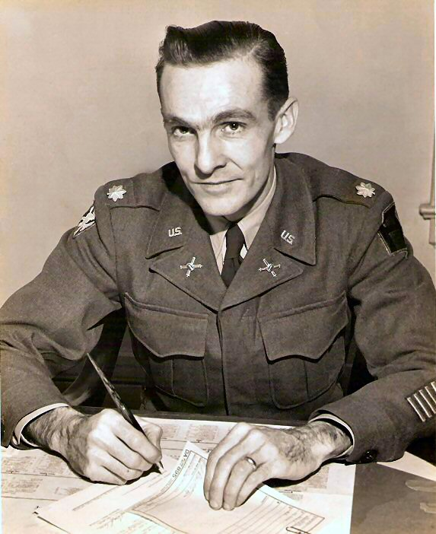
LTC E. D. Winstead, 1951 Ft. Totten, NY

Slide 28
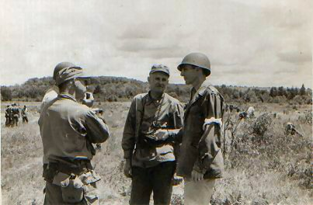
LTC E. D. Winstead (on right) on inspection team, 1951 Ft. Drum, NY

Slide 29
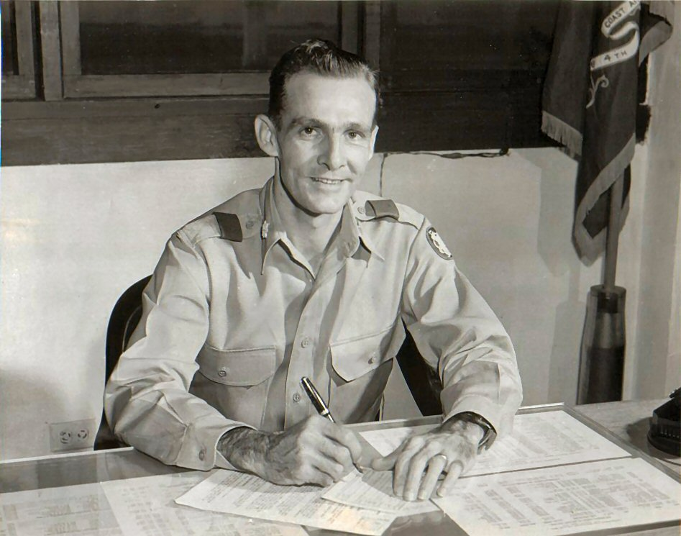
1953 LTC E. D. Winstead, Post Commander, Ft. Davis, Panama Canal Zone

Slide 30
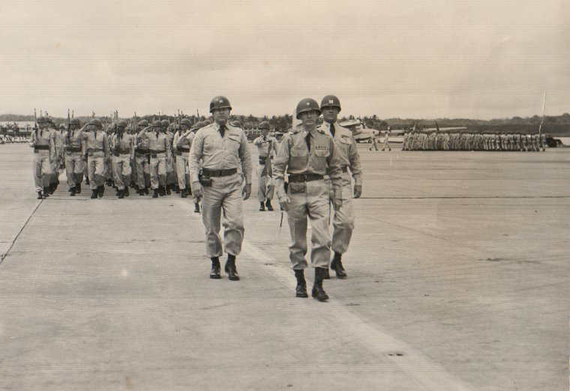
1953 LTC E. D. Winstead, Post Commander, Ft. Davis, Panama Canal Zone

Slide 31
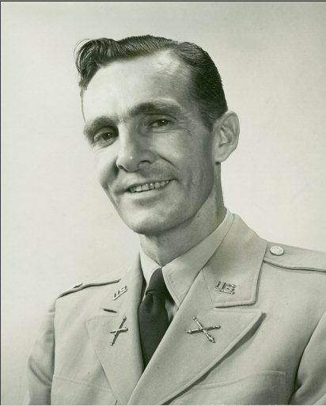
1953 LTC E. D. Winstead, Post Commander, Ft. Davis, Panama Canal Zone

Slide 32
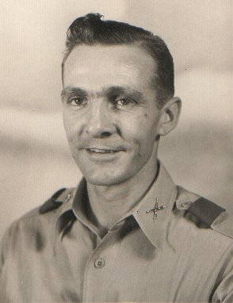
1953 LTC E. D. Winstead, Post Commander, Ft. Davis, Panama Canal Zone

Slide 33
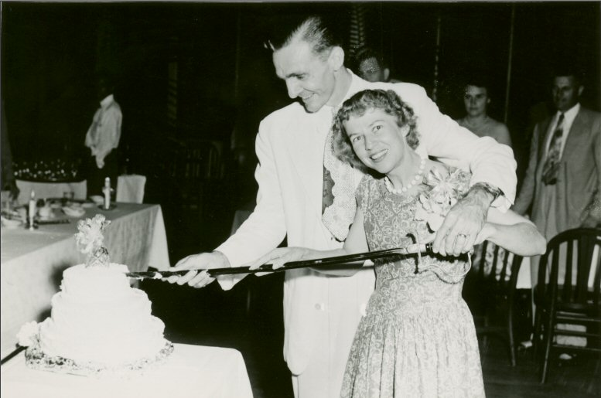
E. D. Winstead and Jo Winstead's 15th Wedding Anniversary party - 1953.

Slide 34
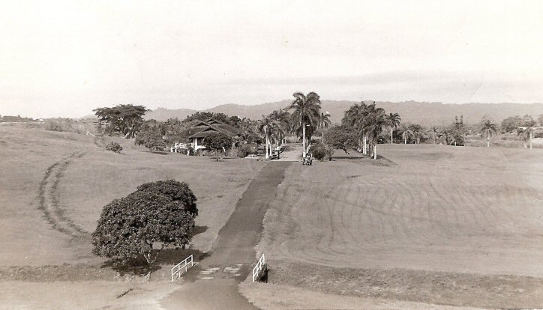
Residence of LTC E. D. Winstead while Post Commander (first house on left),
Ft. Davis, Panama Canal Zone

Slide 35
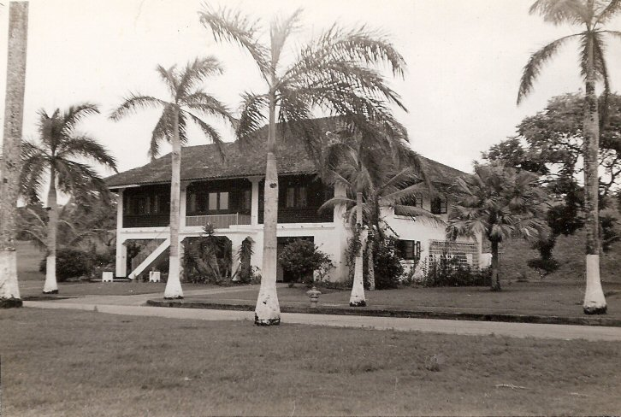
Residence of LTC E. D. Winstead while Post Commander,
Ft. Davis, Panama Canal Zone

Slide 36
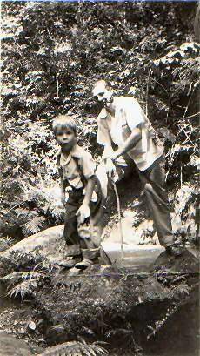
EDW with son Ray in Panama jungle

Slide 37
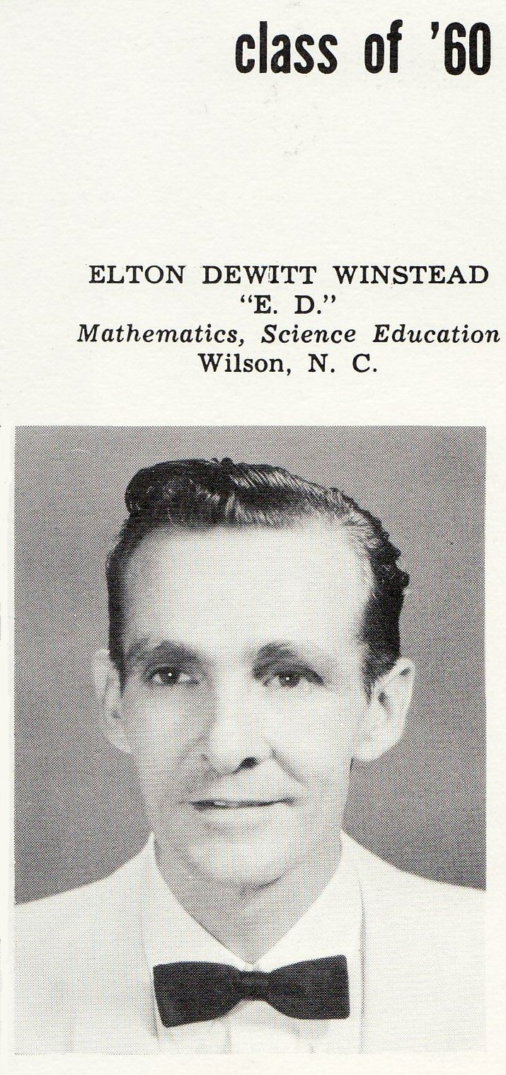
E. D. Winstead as a graduating senior
in 1960 Atlantic Christian College yearbook.

Slide 38
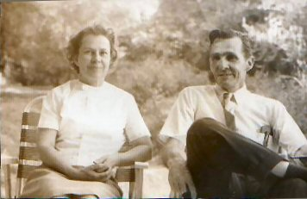
1966 Jo and E. D.

Slide 39
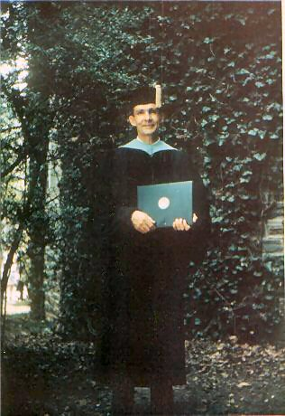
Duke University graduation
with doctoral degree
Professor of Education and Mathematics, Chair of Department of Mathematics,
Atlantic Christian College, Wilson, NC.

Slide 40
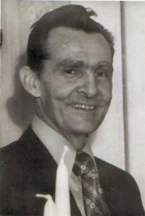
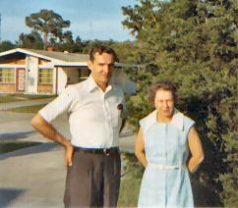
1970 with Jo

Slide 41
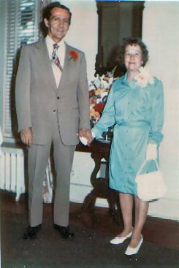
1975 with Jo

Slide 42
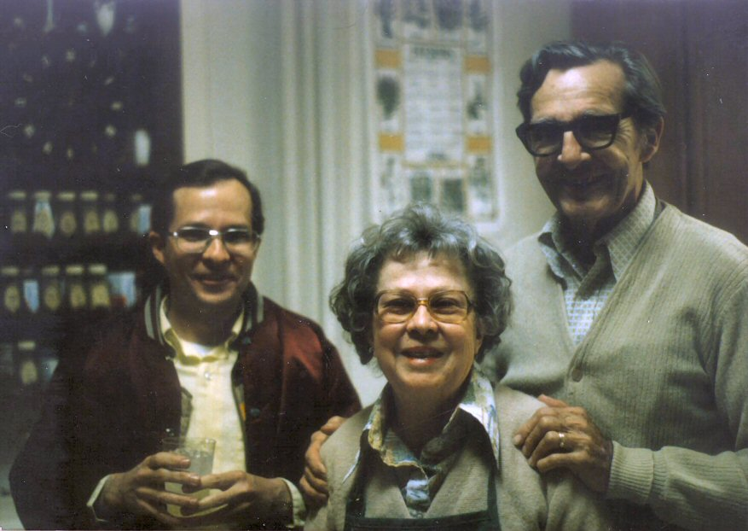
E. D. Winstead March, 1986 with wife Jo and son Ray.

Slide 43
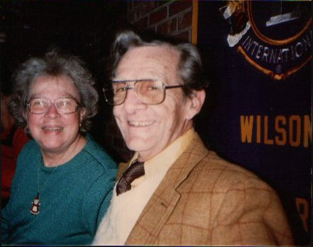
1987 with Jo

Slide 44
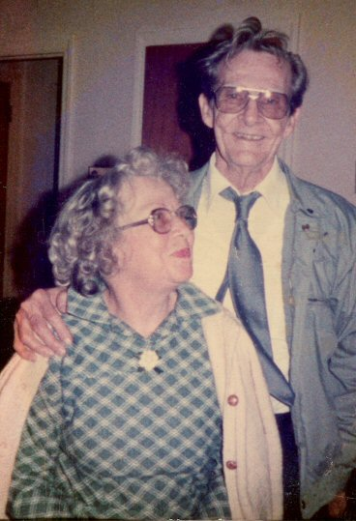
1988 with Jo in Richlands, North Carolina

Slide 45
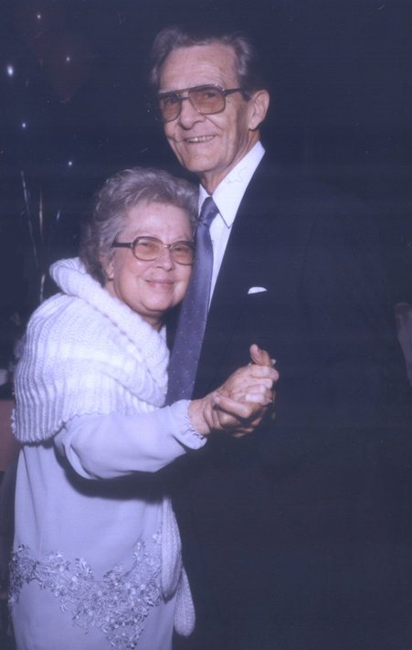
E. D. Winstead and Jo, May 19, 1990 in California

Slide 46
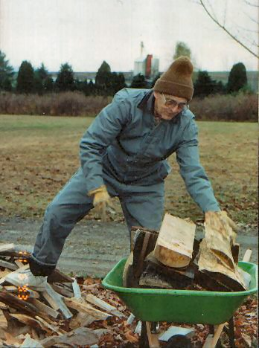
1993 visiting in Penn Run, Pennsylvania (home of son Ray and his wife Dawn)

Slide 47
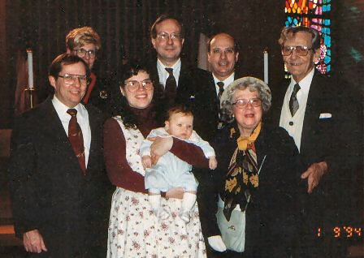
1994 baptism of Grandson Jacob in Tyrone, Pennsylvania
(Son Ray, daughter Sue, Dawn with Jacob, son Gene, son Dee, wife Jo, E. D. Winstead)

Slide 48
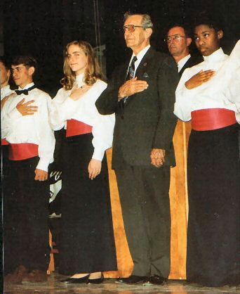
March 31, 1995 "E. D. Winstead Day” Wilson, North Carolina
(Sponsored by Wilson Committee on Patriotism - commemoration of end of WWII)

Slide 49
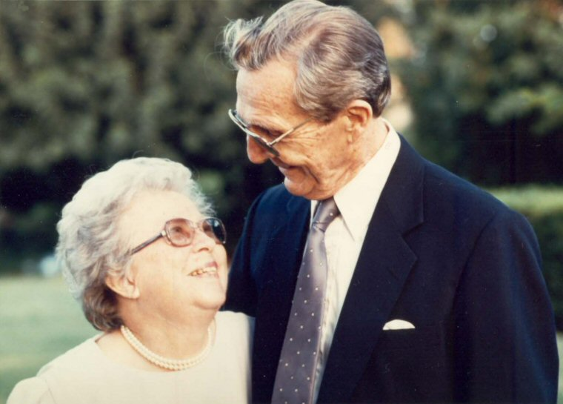
September 1997 with wife Jo

Slide 50
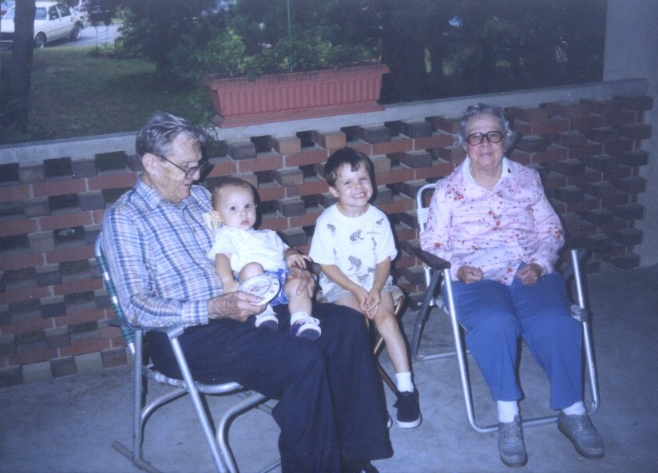
1998 with wife Jo and grandchildren in Durham

Slide 51

90th Birthday
2003

Slide 52

May 2004 with sister Clara at Pippin home - Family Reunion in Wakefield, NC

Slide 53


E. D. Winstead played a saxophone in high school, and both his grandsons now play the sax.
Here are two photos of him playing the sax in late December 2006.

Slide 54

May 20, 2007 attending graduation ceremony at Barton College (Atlantic Christian College)

Slide 55

E. D. Winstead November 4, 2007

Slide 56

August 14, 2007 Bowling
E. D. Winstead bowls about once a week in a local bowling league.

Slide 57

E. D. Winstead Celebrating His 95th Birthday in 2008

Slide 58

E. D. Winstead celebrating his 95th birthday with his friends
Jeannette Ross and Henry Halbert.
2008

Slide 59

E. D. Winstead celebrating his daughter's retirement May 20, 2009 in Los Angeles, California. Sue Winstead Gordon's retirement as Commanding Officer, Personnel Division, Los Angeles Police Department

Slide 60

E. D. Winstead Celebrating His 96th Birthday in 2009

Slide 61

E. D. Winstead Celebrating His 97th Birthday in 2010

Slide 62

E. D. Winstead celebrating his 97th birthday with family in 2010.

Slide 63

Frank and Nettie Winstead,
E. D. Winstead's parents, in 1906.

Slide 64

Baby E. D. Winstead in 1914
with parents
Frank Jefferson Winstead and Nettie Strickland Winstead
at Strickland's Crossroads
in Nash County, North Carolina

Slide 65

E. D. Winstead in 1926 with older brother Ollin (Frank Ollin Winstead) and younger sister Clara Winstead.
Strickland's Mill on Tar River near Strickland's Crossroads
in Nash County, North Carolina

Slide 66

E. D. Winstead's father
Frank Jefferson Winstead about 1939 at the farm in Wilson, North Carolina.

Slide 67

E. D. Winstead's parents Nettie Strickland Winstead
and Frank Jefferson Winstead in 1964 in Wilson, North Carolina

Slide 68

E. D. Winstead's grandfather "Pa" John Lugeness Winstead
(1854 – 1938)
holding a birthday cake.

